Slide 1

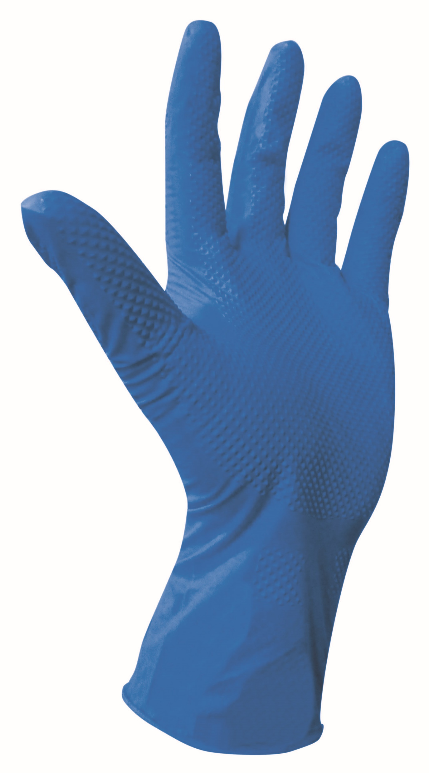
FOOD BUDDY
Product Silience
Composition - Design - Type - Finish - Process -
Tensile (ASTM D 6319 & EN 455-2)
Technical Specification
Tensile(MPA) | Elongation(%) | Force At Break(N)
Length: Thickness: Finger Tip Smooth- Finger Tip texture- Palm Textured- Donning Comfort(Wider Palm Width): (Palm Width Conditional)
Quality Assurance
Visual Inspection G-I AQL | Physical dimension S-II AQL
Leak Test G-I AQL | Physical Properties S-II AQL

Slide 2
International Compliances
CE: Sizing,Dexterity & Mechnical Attribute: Innocuousness & PH: Microbial Penetration & chemical Permeation: Foos Safe Application:
Packaging(Private Labeling & Customizations including multi color Gloves packed in same Dispense.)
Retail Pouch: Retail Dispenser Box: Standard Dispenser Box:
Container Loadability(No MOQ in manufacturer owned brand in standard Packaging)
20 FCL=800 cases,40 FCL=1600 cases,40FCL-Q=1900 cases

